Slide 1
Software Metrics

Slide 2
Questions
How big is the program?
Huge!!
How close are you to finishing?
We are almost there!!
Can you, as a manager, make any useful decisions from such subjective information?
Need information like, cost, effort, size of project.

Slide 3
Metrics
Quantifiable measures that could be used to measure characteristics of a software system or the software development process
Required in all phases
Required for effective management
Managers need quantifiable information, and not subjective information
Subjective information goes against the fundamental goal of engineering

Slide 4
Measurement
Measurement is fundamental to any engineering discipline
Software Metrics - Broad range of measurements for computer software
Software Process - Measurement can be applied to improve it on a continuous basis
Software Project - Measurement can be applied in estimation, quality control, productivity assessment & project control
Measurement can be used by software engineers in decision making.

Slide 5
Why Measure Software?
Determine the quality of the current product or process
Predict qualities of a product/process
Improve quality of a product/process

Slide 6
Definitions
Measure - Quantitative indication of the extent, amount, dimension, capacity or size of some attribute of a product or process.
E.g., Number of errors
Measurement - The act of determining a measure
Metric - A quantitative measure of the degree to which a system, component, or process possesses a given attribute
E.g., Number of errors found per person hours expended

Slide 7
Definitions
Indicator – An indicator is a metric or combination of metrics that provide insight into the software process, a software project or the product itself.
Direct Metrics: Immediately measurable attributes (e.g. line of code, execution speed, defects reported)
Indirect Metrics: Aspects that are not immediately quantifiable (e.g. functionality, quantity, reliability)
Faults:
Errors: Faults found by the practitioners during software development
Defects: Faults found by the customers after release

Slide 8
Why Do We Measure?
To indicate the quality of the product.
To assess the productivity of the people who produce the product
To assess the benefits derived from new software engineering methods and tools
To form a baseline for estimation
To help justify requests for new tools or additional training
Estimate the cost & schedule of future projects
Forecast future staffing needs
Anticipate and reduce future maintenance needs

Slide 9
Example Metrics
Defect rates
Error rates
Measured by:
individual
module
during development
Errors should be categorized by origin, type, cost

Slide 10
A Good Manager Measures
process
process metrics
project metrics
measurement
product metrics
product
What do we
“Not everything that can be counted counts, and not everything that counts can be counted.” - Einstein
use as a
basis?
• size?
• function?

Slide 11
Software Metrics
Pressman explained as "A measure provides a quantitative
indication of the extent, amount, dimension, capacity, or size of some attribute of the product or process”.
Measurement is the act of determine a measure
The metric is a quantitative measure of the degree to
which
given
a
system,
component,
or
process possesses a
attribute.
Fenton defined measurement as " it is the process by
which
numbers or symbols are assigned to attributes of entities in
the real world in such a way as to describe them according to clearly defined rules”.

Slide 12
Software Metrics
•
Definition
Software metrics can be defined as "The continuous
application of
development
measurement
based
techniques
to
the
software
meaningful
process
and
its
products
to
supply
and
timely
management information, together with the
to improve that process and its products”.
use
of
those
techniques

Slide 13
Software Metrics
• Areas of Applications
The
most established
area
of
software
metrics
is
cost
and
size
estimation techniques.
The
prediction
of
quality
levels
for
software,
often in
terms
of
reliability, is another area where software metrics have an
role to play.
important
The
use
of
software metrics
to
provide
quantitative
checks
on
software design is also a well established area.
7

Slide 14
Software Metrics
•
Categories of Metrics
i.
Product metrics: describe the characteristics of the
product
such
as
size,
complexity,
design
features,
performance, efficiency, reliability, portability, etc.
Process metrics: describe the effectiveness and
ii.
quality
of
the
processes
that
produce
the
software
product. Examples are:
•
•
•
•
•
effort required in the process
time to produce the product
effectiveness of defect removal
number of defects found during
maturity of the process
during development
testing
7

Slide 15
Software Metrics
iii.
Project
metrics: describe the project characteristics
and execution. Examples are :
•
number of software developers
•
staffing pattern over
the
life
cycle
of
the
software
•
cost and schedule
•
productivity

Slide 16
Process Metrics
Process metrics are measures of the software development process, such as
Overall development time
Type of methodology used
Process metrics are collected across all projects and over long periods of time.
Their intent is to provide indicators that lead to long-term software process improvement.

Slide 17
Process Metrics & Software Process Improvement
To improve any process, the rational way is:
Measure Specific attributes of the process
Derive meaningful metrics from these attributes.
Use these metrics to provide indicators.
The indicators lead to a strategy for improvement.

Slide 18
Process Metrics
Focus on quality achieved as a consequence of a repeatable or managed process. Strategic and Long Term.
Statistical Software Process Improvement (SSPI). Error Categorization and Analysis:
All errors and defects are categorized by origin
The cost to correct each error and defect is recorded
The number of errors and defects in each category is computed
Data is analyzed to find categories that result in the highest cost to the organization
Plans are developed to modify the process
Defect Removal Efficiency (DRE). Relationship between errors (E) and defects (D). The ideal is a DRE of 1:

Slide 19
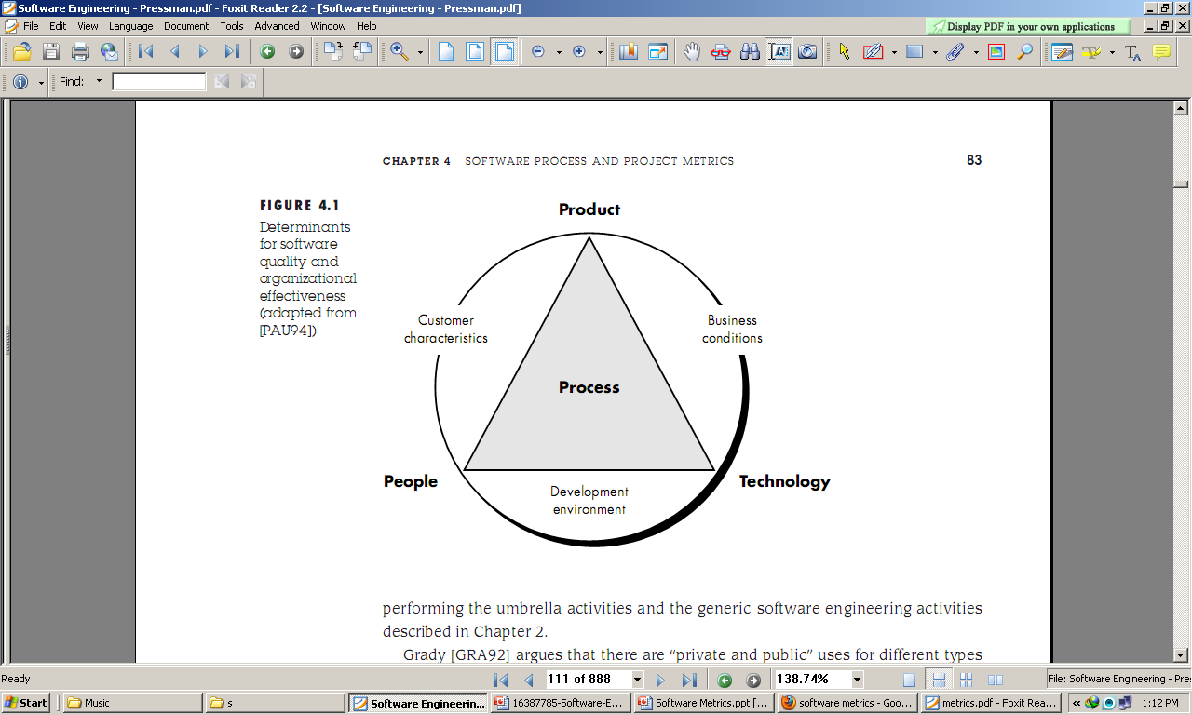
Factors Affecting Software Quality

Slide 20
How to Measure Effectiveness of a Software Process
We measure the effectiveness of a software process indirectly
We derive a set of metrics based on the outcomes that can be derived from the process.
Outcomes include
Errors uncovered before release of the software
Defects delivered to and reported by end-users
Work products delivered (productivity)
Human effort
Calendar time etc.
Conformance to schedule

Slide 21
Project Metrics
Project Metrics are the measures of Software Project and are used to monitor and control the project. They enable a software project manager to:
Minimize the development time by making the adjustments necessary to avoid delays and potential problems and risks.
Assess product quality on an ongoing basis & modify the technical approach to improve quality.

Slide 22
Project Metrics
Used in estimation techniques & other technical work.
Metrics collected from past projects are used as a basis from which effort and time estimates are made for current software project.
As a project proceeds, actual values of human effort & calendar time expended are compared to the original estimates.
This data is used by the project manager to monitor & control the project.

Slide 23
Project Metrics
Used by a project manager and software team to adapt project work flow and technical activities.
Metrics:
Effort or time per SE task
Errors uncovered per review hour
Scheduled vs. actual milestone dates
Number of changes and their characteristics
Distribution of effort on SE tasks

Slide 24
Product metrics
Product metrics are measures of the software product at any stage of its development, from requirements to installed system. Product metrics may measure:
the complexity of the software design
the size of the final program
the number of pages of documentation produced

Slide 25
Types of Software Measurements
Direct measures
Easy to collect
E.g. Cost, Effort, Lines of codes (LOC), Execution Speed, Memory size, Defects etc.
Indirect measures
More difficult to assess & can be measured indirectly only.
Quality, Functionality, Complexity, Reliability, Efficiency, Maintainability etc.

Slide 26
An example
2 different project teams are working to record errors in a software process
Team A – Finds 342 errors during software process before release
Team B- Finds 184 errors
Which team do you think is more effective in finding errors?

Slide 27
Normalization of Metrics
To answer this we need to know the size & complexity of the projects.
But if we normalize the measures, it is possible to compare the two
Normalization: compensate for complexity aspects particular to a product
For normalization we have 2 ways-
Size-Oriented Metrics
Function Oriented Metrics

Slide 28
Metrics Guidelines
Use common sense and organizational sensitivity when interpreting metrics data
Provide regular feedback to the individuals and teams who have worked to collect measures and metrics.
Don’t use metrics to appraise individuals
Work with practitioners and teams to set clear goals and metrics that will be used to achieve them
Never use metrics to threaten individuals or teams
Metrics data that indicate a problem area should not be considered “negative.” These data are merely an indicator for process improvement
Don’t obsess on a single metric to the exclusion of other important metrics

Slide 29
Typical Normalized Metrics
Project | LOC | FP | Effort (P/M) | R(000) | Pp. doc | Errors | Defects | People
alpha | 12100 | 189 | 24 | 168 | 365 | 134 | 29 | 3
beta | 27200 | 388 | 62 | 440 | 1224 | 321 | 86 | 5
gamma | 20200 | 631 | 43 | 314 | 1050 | 256 | 64 | 6
Size-Oriented:
errors per KLOC (thousand lines of code), defects per KLOC, R per LOC, page of documentation per KLOC, errors / person-month, LOC per person-month, R / page of documentation
Function-Oriented:
errors per FP, defects per FP, R per FP, pages of documentation per FP, FP per person-month

Slide 30
Size-Oriented Metrics
Based on the “size” of the software produced
LOC - Lines Of Code
KLOC - 1000 Lines Of Code
SLOC – Statement Lines of Code (ignore whitespace)
Typical Measures:
Errors/KLOC, Defects/KLOC, Cost/LOC, Documentation Pages/KLOC

Slide 31
Size-Oriented Metrics

Slide 32
From the above data, simple size oriented metrics can be developed for each Project
Errors per KLOC
$ per KLOC
Pages of documentation per KLOC
Errors per person-month
LOC per person-month
Advantages of Size Oriented Metrics
LOC can be easily counted
Many software estimation models use LOC or KLOC as input.
Disadvantages of Size Oriented Metrics
LOC measures are language dependent, programmer dependent
Their use in estimation requires a lot of detail which can be difficult to achieve.
Useful for projects with similar environment

Slide 33
Complexity Metrics
LOC - a function of complexity
Language and programmer dependent
Halstead’s Software Science (entropy measures)
n₁ - number of distinct operators
n₂ - number of distinct operands
N₁ - total number of operators
N₂ - total number of operands

Slide 34
Example
if (k < 2)
{
if (k > 3)
x = x*k;
}
Distinct operators: if ( ) { } > < = * ;
Distinct operands: k 2 3 x
n₁ = 10
n₂ = 4
N₁ = 13
N₂ = 7

Slide 35
Halstead’s Metrics
Amenable to experimental verification [1970s]
Program length: N = N₁ + N₂
Program vocabulary: n = n₁ + n₂
Estimated length: = n₁ log₂ n₁ + n₂ log₂ n₂
Close estimate of length for well structured programs
Purity ratio: PR = /N

Slide 36

Program Complexity
Volume: V = N log₂ n
Number of bits to provide a unique designator for each of the n items in the program vocabulary.
Difficulty
Program effort: E=D*V
This is a good measure of program understandability

Slide 37
McCabe’s Complexity Measures
McCabe’s metrics are based on a control flow representation of the program.
A program graph is used to depict control flow.
Nodes represent processing tasks (one or more code statements)
Edges represent control flow between nodes

Slide 38
Cyclomatic Complexity
Set of independent paths through the graph (basis set)
V(G) = E – N + 2
E is the number of flow graph edges
N is the number of nodes
V(G) = P + 1
P is the number of predicate nodes

Slide 39
Meaning
V(G) is the number of (enclosed) regions/areas of the planar graph
Number of regions increases with the number of decision paths and loops
A quantitative measure of testing difficulty and an indication of ultimate reliability
Experimental data shows value of V(G) should be no more then 10 - testing is very difficulty above this value

Slide 40
McClure’s Complexity Metric
Complexity = C + V
C is the number of comparisons in a module
V is the number of control variables referenced in the module
decisional complexity
Similar to McCabe’s but with regard to control variables

Slide 41
Function-Oriented Metrics
Based on “functionality” delivered by the software
Functionality is measured indirectly using a measure called function point.
Function points (FP) - derived using an empirical relationship based on countable measures of software & assessments of software complexity

Slide 42
Steps In Calculating FP
1. Count the measurement parameters.
2. Assess the complexity of the values.
3. Calculate the raw FP (see next table).
4. Rate the complexity factors to produce the complexity adjustment value (CAV)
5. Calculate the adjusted FP as follows:
FP = raw FP x [0.65 + 0.01 x CAV]

Slide 43
Function Point Metrics
Parameter Count Simple Average Complex
Inputs x 3 4 6 =
Outputs x 4 5 7 =
Inquiries x 3 4 6 =
Files x 7 10 15 =
Interfaces x 5 7 10 =
Count-total (raw FP)

Slide 44
Rate Complexity Factors
For each complexity adjustment factor, give a rating on a scale of 0 to 5
0 - No influence
1 - Incidental
2 - Moderate
3 - Average
4 - Significant
5 - Essential

Slide 45
Complexity Adjustment Factors
Does the system require reliable backup and recovery?
Are data communications required?
Are there distributed processing functions?
Is performance critical?
Will the system run in an existing, heavily utilized operational environment?
Does the system require on-line data entry?
Does the on-line data entry require the input transaction to be built over multiple screens or operations?

Slide 46
Complexity Adjustment Factors(Continue…)
Are the master files updated on-line?
Are the inputs, outputs, files, or inquiries complex?
Is the internal processing complex?
Is the code designed to be reusable?
Are conversion and installation included in the design?
Is the system designed for multiple installations in different organizations?
Is the application designed to facilitate change and ease of use by the user?

Slide 47
Complexity Adjustment Value
The rating for all the factors, F₁ to F₁₄, are summed to produce the complexity adjustment value (CAV)
CAV is then used in the calculation of the function point (FP) of the software

Slide 48
Example of Function-Oriented Metrics
Errors per FP
Defects per FP
$ per FP
Pages of documentation per FP
FP per person month

Slide 49
FP Characteristics
Advantages: language independent, based on data known early in project, good for estimation
Disadvantages: calculation complexity, subjective assessments, FP has no physical meaning (just a number)

Slide 50
Software Metrics
Token Count
The
size
of
the
vocabulary of
a
program,
which
consists
of
the
number
of
unique tokens used to build a program
is
defined
as:
η
η
= η1+ η2
: vocabulary of a program
where
η1 : number of unique operators
η₂ : number of unique operands

Slide 51
Software Metrics
The length of the program in the
used is
terms of the
total
number
of
tokens
N = N1+N2
N
: program length
where
N1 : total occurrences
N₂ : total occurrences
of operators
of operands

Slide 52
Software Metrics
Volume
V = N * log2 η
The unit of measurement of volume is the
common unit for
size
"bits”.
It
is the
actual
size
of
a
program
if
a
uniform
binary encoding for the vocabulary
is used.
Program Level
L = V* / V
The
value
of
L
ranges
between
zero
and
one,
with
L=1
representing a program written at
(i.e., with minimum size).
the highest possible level

Slide 53
Software Metrics
Program Difficulty
D = 1 / L
As the volume of an implementation
of a program
the difficulty
increases,
increases.
the
program
level
decreases
and
such
Thus,
programming practices
as
redundant
usage
of
operands, or the failure to use
higher-level control constructs
will tend to increase the volume as well as the difficulty.
Effort
E = V / L = D * V
The
unit
of
measurement
of
E
is
elementary
mental
discriminations.

Slide 54
Software Metrics
•
Estimated Program Length
∧
Ν = η ₁
∧
Ν = 14
log η ₁ + η
log η
2
2
2
2
log₂ 14 + 10 log₂ 10
= 53.34 + 33.22 = 86.56
The
following
alternate expressions
have
been
published
to
estimate program length.
= Log₂ (η₁!) + log₂ (η₂!)
Ν _{J}

Slide 55
Software Metrics
Ν _{B} = η₁ Log ₂η₂ +η₂ log₂ η₁
Ν _{c} = η₁
η₁ + η₂
η₂
Ν _{s}
= (η
log₂ η ) /
2
operators,
The
definitions
of unique
unique
operands,
total
operators and total operands are not specifically delineated.

Slide 56
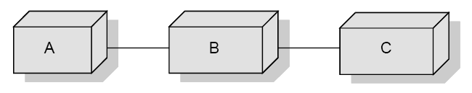
Software Metrics
• The Sharing of Data Among Modules
A program normally contains several modules
and share coupling
among
modules. However, it may be desirable
to
know
the
amount
of
data
being
shared
among
the
modules.
Fig.: Three modules from an imaginary program

Slide 57
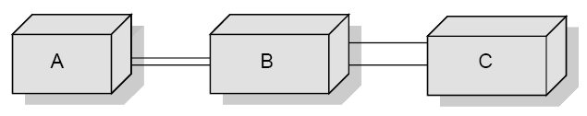
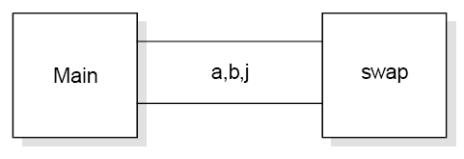
Software Metrics
Fig.: ”Pipes” of data shared among the modules
Fig.: The data shared in program bubble

Slide 58
Software Metrics
Information
Flow
Metrics
Component
:
Any element identified by
decomposing a
its constituent
(software)
parts.
system
into
Cohesion
:
The
degree
to which
a
component
performs a single function.
Coupling
:
The term used to describe the degree of
linkage between one
component
to
others in the same system.

Slide 59
Software Metrics
•
The Basic Information Flow Model
Information
Flow
metrics
are
applied
to
the
Components
of
a
system design. Fig. 13 shows a fragment of such a design, and for
component ‘A’ we can define three measures, but remember that these are the simplest models of IF.
1.
‘FAN IN’ is simply a count of the number of other Components
that can call, or pass control, to Component A.
2.
‘FANOUT’
is
the
number
of
Components
that
are
called
by
Component A.
This is derived from the first two by using the following formula. We will call this measure the INFORMATION FLOW index of Component A, abbreviated as IF(A).
IF(A) = [FAN IN(A) x FAN OUT (A)]²
3.

Slide 60
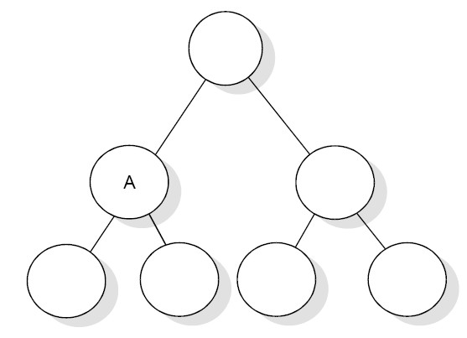
Software Metrics
Fig.: Aspects of complexity

Slide 61
Software Metrics
The following is a step-by-step guide to
deriving these most simple
of
IF metrics.
1.
Note the level of each Component in
the system design.
2.
For
each
Component,
count the
number
of
calls
so
that
Component
–
this is
the FAN
IN
of
that
Component.
Some
organizations allow more than one Component at the highest
level in the design, so for Components at the highest level which should have a FAN IN of zero, assign a FAN IN of one. Also
note
that
a
simple
model
of
FAN
IN
can
penalize
reused
Components.
3.
For
each
Component,
count
the
number
of
calls
from
the
Component. For Component that call no other, assign a FAN
OUT value of one.
cont…

Slide 62
Software Metrics
4.
Calculate
formula.
the
IF value for
each
Component
using
the
above
5.
Sum the IF value for all Components
called as the LEVEL SUM.
within each level which is
6.
Sum the IF values for the total system
SYSTEM SUM.
For each level, rank the Component
design which is called the
7.
in that level according to
FAN IN, FAN OUT and IF values. Three histograms or line plots
should be prepared for each level.
Plot the LEVEL SUM values for each level using a histogram or line plot.
8.

Slide 63
Software Metrics
•
a b
A More Sophisticated Information Flow Model
= the number of components that call A.
= the number of parameters passed
higher in the hierarchy.
= the number of parameters passed
to A from components
c
to A from components
lower in the
= the number
hierarchy.
of data elements read by
d
component A.
Then:
FAN IN(A)= a + b + c
+ d

Slide 64
Software Metrics
Also let:
e = the number of components called by A;
f = the number of parameters passed from A to in the hierarchy;
components
higher
g = the number of parameters passed from A to
in the hierarchy;
components
lower
h = the
number of data elements written to by A.
Then:
FAN OUT(A)= e + f + g + h

Slide 65
Object Oriented Metrics
Terminologies
S.No
Term
Meaning/purpose
1
Object
Object is an entity able to save a state (information) and offers a number of operations (behavior) to either examine or affect this state.
2
Message
A request that an object makes of another object to perform an operation.
3
Class
A set of objects that share a common structure and common behavior manifested by a set of methods; the set serves as a template from which object can be created.
4
Method
an operation upon an object, defined as part of the declaration of a class.
5
Attribute
Defines the structural properties of a class and unique within a class.
6
Operation
An action performed by or on an object, available to all instances of class, need not be unique.

Slide 66
Object Oriented Metrics
Terminologies
S.No
Term
Meaning/purpose
7
Instantiation
The process of creating an instance of the object and binding or adding the specific data.
8
Inheritance
A relationship among classes, where in an object in a class acquires characteristics from one or more other classes.
9
Cohesion
The degree to which the methods within a class are related to one another.
10
Coupling
Object A is coupled to object B, if and only if A
sends a message to B.

Slide 67
Object Oriented Metrics
•
Measuring on class
level
–
–
–
–
–
coupling
inheritance
methods
attributes
cohesion
•
Measuring on
system
level

Slide 68
Object Oriented Metrics
Size Metrics:
•
Number of Methods per Class (NOM)
•
Number of Attributes per Class (NOA)
•
Weighted Number Methods in a Class (WMC)
–
Methods
implemented
within
a
class
or
the
sum
of
the
complexities of all methods

Slide 69
Object Oriented Metrics
Coupling Metrics:
•
Response for a Class (RFC )
–
Number of methods (internal and external)
in
a
class.
•
Data Abstraction Coupling(DAC)
-
Number of Abstract Data Types in a class.
•
Coupling between Objects (CBO)
–
Number of other classes to which it is coupled.

Slide 70
Object Oriented Metrics
•
Message Passing Coupling (MPC)
–
Number of send statements defined in a class.
•
Coupling Factor (CF)
–
Ratio of actual number of coupling
the max. possible coupling.
in
the
system
to

Slide 71
Object Oriented Metrics
Cohesion Metrics:
•
LCOM: Lack of cohesion in methods
–
Consider a class C1 with n methods M1, M2….,
Mn. Let (Ij)
= set of all instance variables used by method Mi. There
^{are n such sets {I}1^{},…….{I}n^{}. Let}
P = {(I_{i} , I _{j} ) | I_{i} ∩ I _{j} = 0} andQ = {((I_{i} , I _{j} ) | I_{i} ∩ I _{j} ≠ 0}
If
all n {( I1 },........ .(I n )}sets
are
0 then P=0
LCOM =| P | - | Q |, if |
= 0 otherwise
P | > | Q |

Slide 72
Object Oriented Metrics
•
Tight Class Cohesion (TCC)
_
with
Percentage of pairs of public methods
common attribute usage.
of the
class
•
Loose Class Cohesion (LCC)
–
Same
as
TCC
except
that
this
metric
also
consider indirectly connected methods.
Information based Cohesion (ICH)
•
–
Number of invocations of other methods of the same
class, weighted by the number of parameters
invoked method.
of
the

Slide 73
Object Oriented Metrics
Inheritance Metrics:
•
DIT - Depth of inheritance tree
•
NOC - Number of children
–
only
immediate
subclasses
are
counted.

Slide 74
Object Oriented Metrics
Inheritance Metrics:
•
AIF- Attribute Inheritance Factor
–
Ratio of the sum of inherited attributes in
all
all
classes
classes.
of
the
system to the total number of
∑ _{i =1} A _{d} (C _{i} )
attributes
for
TC
AIF =
∑
TC
i =1
A_{a} (C
)
i
A_{a}(C_{i} ) = A_{i}(C_{i} ) + A_{d} (C_{i} )
TC= total number of classes
Ad (Ci) = number of attribute
declared in a
class
Ai (Ci) = number of attribute inherited in a class

Slide 75
Object Oriented Metrics
Inheritance Metrics:
•
MIF- Method Inheritance Factor
–
Ratio of the sum of inherited methods in all
classes
classes.
of
the
system to the total number of methods for
∑_{i =1} Mi(Ci)
all
TC
MIF =
TC
∑_{i =1} ^{Ma(Ci)}
M a(C i) = M i(C i) + M d(C i)
TC= total number of classes
Md(Ci)= the number of methods declared in a class
Mi(Ci)= the number of methods inherited in a class

Slide 76
Use-Case
Oriented
Metrics
•
Counting
actors
Type
Description
Factor
Simple
Program interface
1
Average
Interactive or protocol driven interface
2
Complex
Graphical interface
3
Actor weighting factors
Simple actor: represents another system with a defined
o
o
interface.
Average actor: another system that interacts through a text based
interface through a protocol such as TCP/IP.
Complex actor: person interacting through a GUI interface.
o
The actors weight can be calculated by adding these values together.

Slide 77
Use-Case
Oriented
Metrics
•
Counting
use
cases
Type
Description
Factor
Simple
3 or fewer transactions
5
Average
4 to 7 transactions
10
Complex
More than 7 transactions
15
Transaction-based
weighting factors
The number of each use case type is counted in the
software and
then each number is multiplied by a weighting factor as shown in
table above.

Slide 78
Web Engineering
Project
Metrics
9
9
9
9
9
9
9
9
Number
Number
Number
of
of of
static web pages
dynamic web pages internal page links
Word count
Web page similarity
Web page search and retrieval Number of static content objects Number of dynamic content objects

Slide 79
Metrics Analysis
Statistical Techniques
•
•
Summary statistics such as mean, median, max.
Graphical representations such as histograms, box plots.
Principal component analysis
Regression and correlation analysis
and
pie
min.
charts
and
•
•
•
Reliability models for predicting future
reliability.

Slide 80
Metrics
Analysis
Problems with metric data:
•
•
•
•
Normal Distribution
Outliers
Measurement Scale
Multicollinearity

Slide 81
Metrics Analysis
Common pool of data:
•
The selection of projects should be representative and not all
come from a single application domain or development styles.
•
No single
pool.
very large project should be allowed to dominate the
•
For
some
projects,
certain
metrics
may
not
have
been
collected.

Slide 82
Metrics Analysis
Pattern of Successful Applications:
•
•
•
•
•
•
•
•
Any metric is better then none.
Automation is essential.
Empiricism is better then theory.
Use multifactor rather then single
metrics.
Don’t confuse productivity
Let them mature. Maintain them. Let them die.
metrics
with
complexity
metrics.

Slide 83
Qualities of a good metric
simple, precisely definable—so that it is
clear how the metric can be evaluated;
objective, to the greatest extent possible;
easily obtainable (i.e., at reasonable cost);
valid—the metric should measure what it
is intended to measure; and
robust—relatively insensitive to (intuitive-
ly) insignificant changes in the process or
product.

Slide 84
References
Software Engineering -KK Aggarwal and Yogesh Singh.
Software Engineering: A Practitioner's Approach- Roger S. Pressman

